Slide 1
Angular Forms

Slide 2
What is Angular Forms
Angular forms are used to handle user's input.
Forms are an integral part of a web application.
Angular forms provides different directives to have more control over inputs.

Slide 3
Types of Forms
Template Driven:
Template-driven forms are for simple forms in an application. For example: email list signup form.
Template-driven forms are easy to use in the application but they are not as scalable.
Template-driven forms are mainly used if your application's requires a very basic form and logic. It can easily be managed in a template.

Slide 4
Types of Forms
2. Model/Reactive Forms:
Reactive forms are more robust.
Reactive forms are more scalable, reusable, and testable.
They are most preferred to use if forms are a key part of your application, or your application is already built using reactive patterns. In both cases, reactive forms are best to use.

Slide 5
Operations on Forms
Data Binding
Change Tracking
Validation
Visual Feedback
Error Messages
Form Submission

Slide 6
Angular Forms Process
Template
Class
Service
Server

Slide 7
Template Driven Forms(TDF)
Easy to use and similar to Angular JS forms
Supports two way data binding with ngModel
Bulky HTML and minimum component code
Automatically tracks form and form elements state and validity.
Unit testing is a challenge
Readability decreases with complex forms and validations
Suitable for simple scenarios

Slide 8
Template Driven Forms(TDF)
Tracking States of Forms Control
State | Class if True | Class if False
The control has been visited | ng-touched | ng-untouched
The control’s value has changed | ng-dirty | ng-printine
The control’s value is valid | ng-valid | ng-invalid

Slide 9
Template Driven Forms(TDF)
Level control:
Control levels: Here, we have to check state of each control individually.
Form Level: We can check state of controls using Form state.

Slide 10
Template Driven Forms(TDF)
Directive:
ngForm: Creates a top-level FormGroup instance and binds it to a form to track aggregate form value and validation status
ngControl:Creates and bind a control with a specified name to a DOM element
ngModel: bind form control with component properties

Slide 11
Template Driven Forms(TDF)
Template Variable:
Template variables help you use data from one part of a template in another part of the template. Use template variables to perform tasks such as respond to user input or finely tune your application's forms.

Slide 12
Template Driven Forms(TDF)
A template variable can refer to the following:
a DOM element within a template
a directive or component
a TemplateRef from an ng-template
a web component
Example:
<input #phone placeholder="phone number" />

Slide 13
Template Driven Forms(TDF)
How Angular assigns values to template variables
Angular assigns a template variable a value based on where you declare the variable:
If you declare the variable on a component, the variable refers to the component instance.
If you declare the variable on a standard HTML tag, the variable refers to the element.
If you declare the variable on an <ng-template> element, the variable refers to a TemplateRef instance which represents the template. For more information on <ng-template>,

Slide 14
Template Driven Forms(TDF)
The form UI design can be done with the help of CSS styles.
For the example, we will use bootstrap CSS.
Go to the link:
https://getbootstrap.com/docs/5.3/getting-started/download/

Slide 15
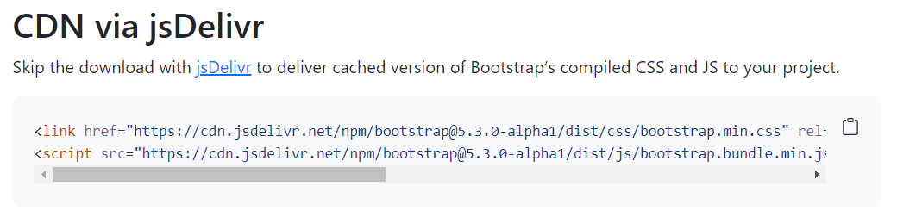
Template Driven Forms(TDF)
Copy the link

Slide 16
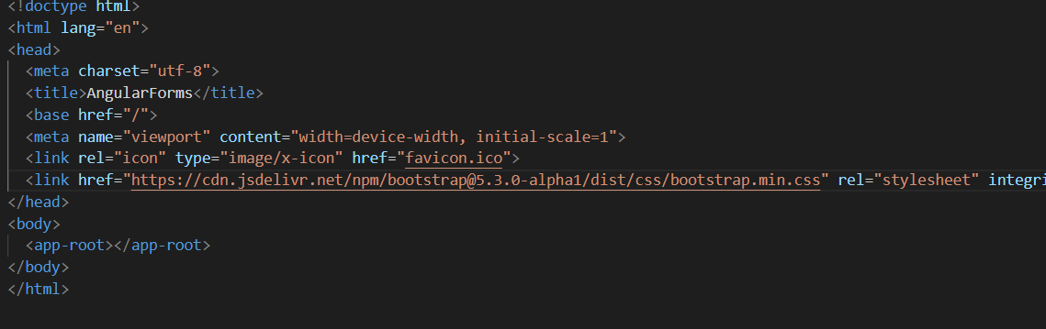
Template Driven Forms(TDF)
Paste in indext.html under head tag

Slide 17
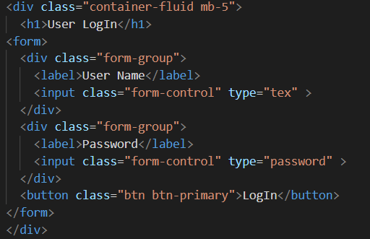
Template Driven Forms(TDF)
A basic LogIn Form

Slide 18
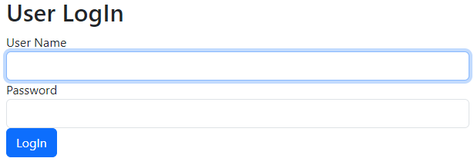
Template Driven Forms(TDF)

Slide 19
Template Driven Forms(TDF)

Slide 20
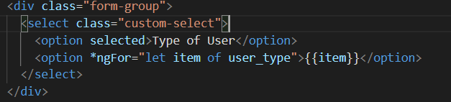
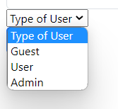

Template Driven Forms(TDF)
Add selection using *ngFor
The output of adding selection
Add array in app.component.ts

Slide 21
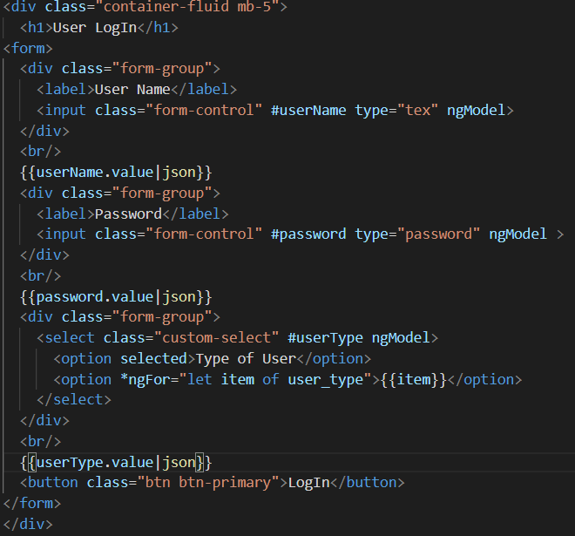
Template Driven Forms(TDF)
Form Data Visualize using ngModel
Template variable

Slide 22
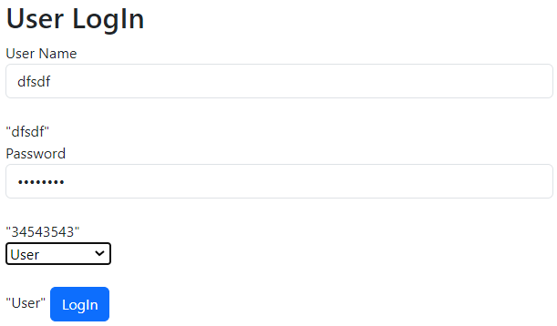
Template Driven Forms(TDF)

Slide 23
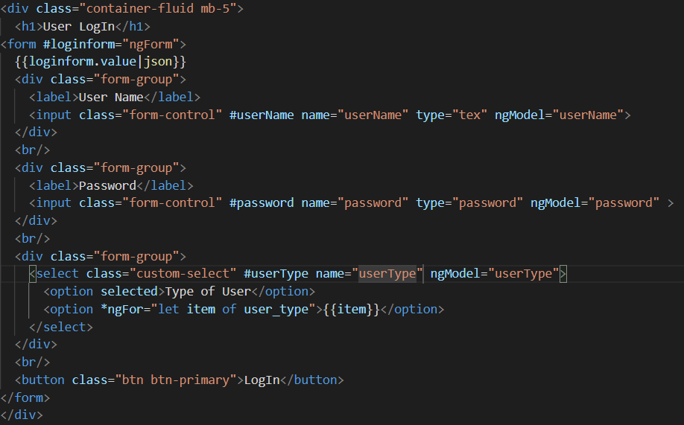
Template Driven Forms(TDF)
Providing names to each control which can provide data binding to each controls

Slide 24
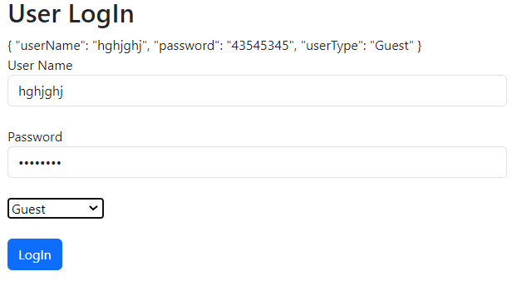
Template Driven Forms(TDF)

Slide 25
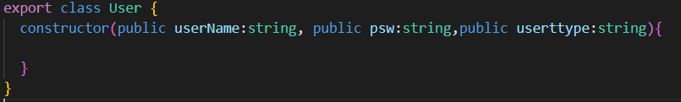
Template Driven Forms(TDF)
Binding Data to a Model:
Model is a class.
It encapsulates form data.
The data transmission becomes simple as we can bind model to form data.
To add model to existing angular project:
ng generate model User

Slide 26
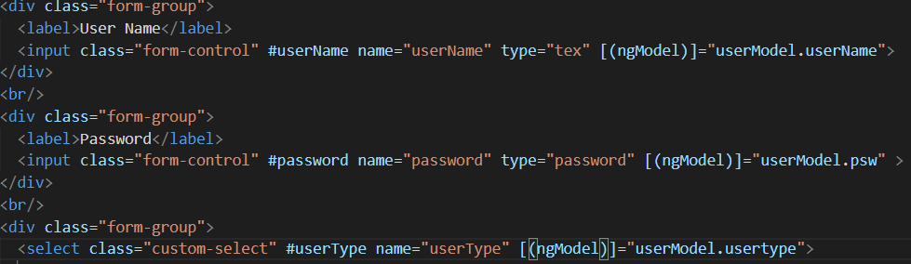

Template Driven Forms(TDF)
app.component.html
app.component.ts

Slide 27
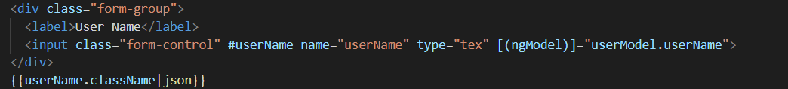


Template Driven Forms(TDF)
Track Control State and Validity
Lets see how we can see change of states
States of control while loading

Slide 28
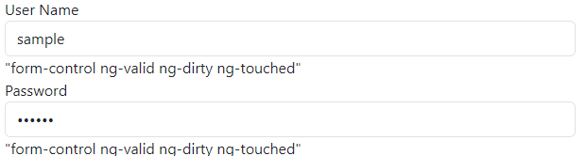
Template Driven Forms(TDF)
Track Control State and Validity
After providing data the state changes

Slide 29
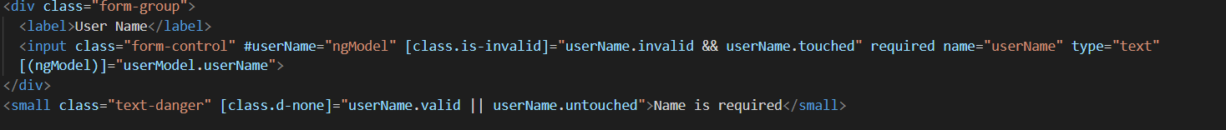
Template Driven Forms(TDF)
How states are used to validate form data?
Decides when to show error message
Decides when to apply validation

Slide 30
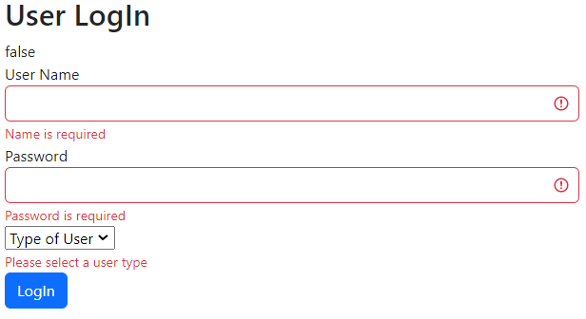
Template Driven Forms(TDF)
How states are used to validate form data?

Slide 31
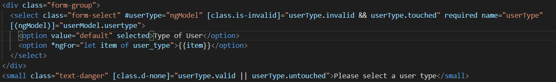
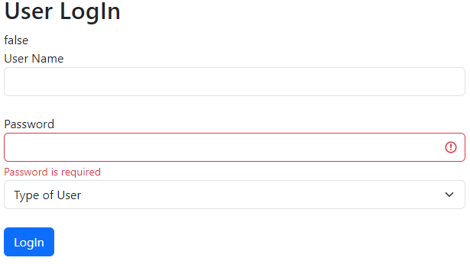
Template Driven Forms(TDF)
How states are used to validate form data?
For default value for select validation fails

Slide 32
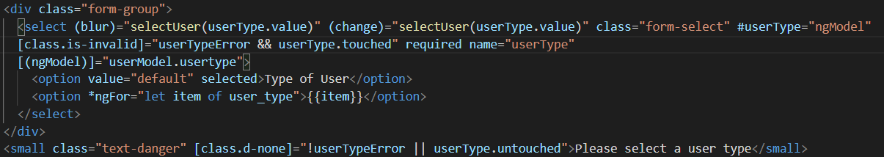
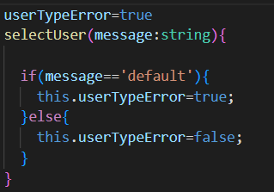
Template Driven Forms(TDF)
How states are used to validate form data?
Blur and change events tracks that we are not selecting default value
App.component.html
App.component.ts

Slide 33
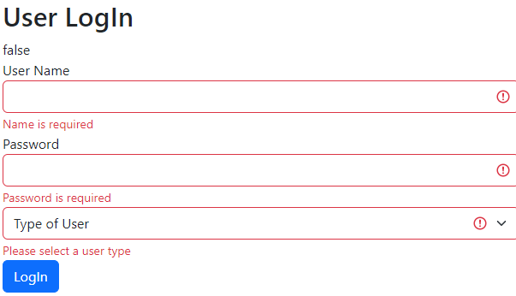
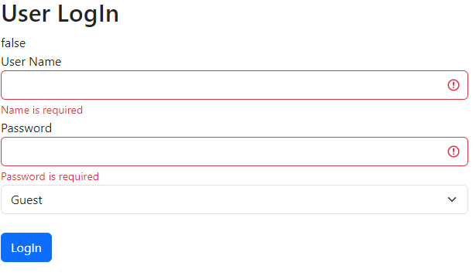
Template Driven Forms(TDF)
How states are used to validate form data?
Validation in select control

Slide 34
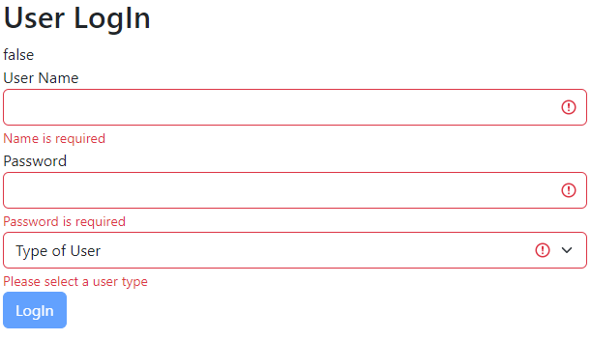
Template Driven Forms(TDF)
How states are used to validate form data?
Loginform is invalid so button is disabled

Slide 35
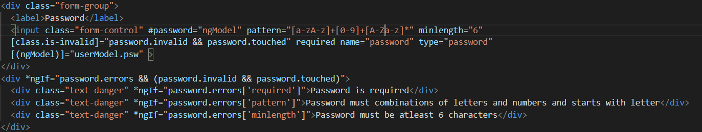
Template Driven Forms(TDF)
How states are used to validate form data?
Pattern and minlength helping to decide what kind of error message should be displayed

Slide 36

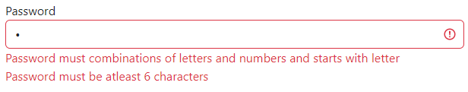
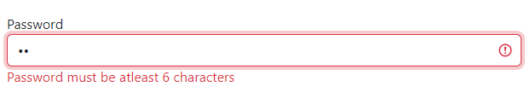
Template Driven Forms(TDF)
How states are used to validate form data?
No password
Password only letter or number
Password length<6

Slide 37
Template Driven Forms(TDF)
How states are used to validate form data?

Slide 38
Template Driven Forms(TDF)
How states are used to validate form data?

Slide 39
Template Driven Forms(TDF)
How states are used to validate form data?

Slide 40
Template Driven Forms(TDF)
How states are used to validate form data?

Slide 41
Template Driven Forms(TDF)
How states are used to validate form data?

Slide 42
Template Driven Forms(TDF)
How states are used to validate form data?

Slide 43
Template Driven Forms(TDF)
How states are used to validate form data?

Slide 44
Template Driven Forms(TDF)
How states are used to validate form data?

